Slide 1
Solvent extraction
BY
Asst. Prof. Lalita A. Patil
Chemistry Department,
S T Co-Op Education Society’s,
Science Senior College, Shahada

Slide 2
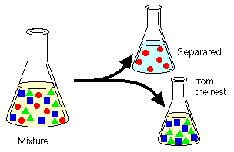
What is liquid-liquid extraction?
Liquid-liquid extraction is a useful method to separate components (compounds) of a mixture.

Slide 3
Distribution coefficient "K"
When shaken, with two immiscible solvents, the compound will distribute itself between the two solvents.
Normally one solvent is water and the other solvent is a water-immiscible organic solvent.
Most organic compounds are more soluble in organic solvents, while some organic compounds are more soluble in water.

Slide 4
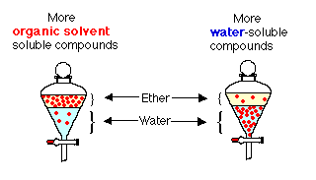

Slide 5

At a certain temperature, the ratio of concentrations of a solute in each solvent is always constant.
This ratio is the
distribution coefficient, K_{D} or partition coefficient.
(solvent1 and solvent2 are immiscible liquids)

Slide 6
Extraction efficiency
Fraction remaining in aqueous phase after one extraction:

Slide 7
After n extractions with V_{org}, the fraction remaining in the aqueous phase is:

Slide 8
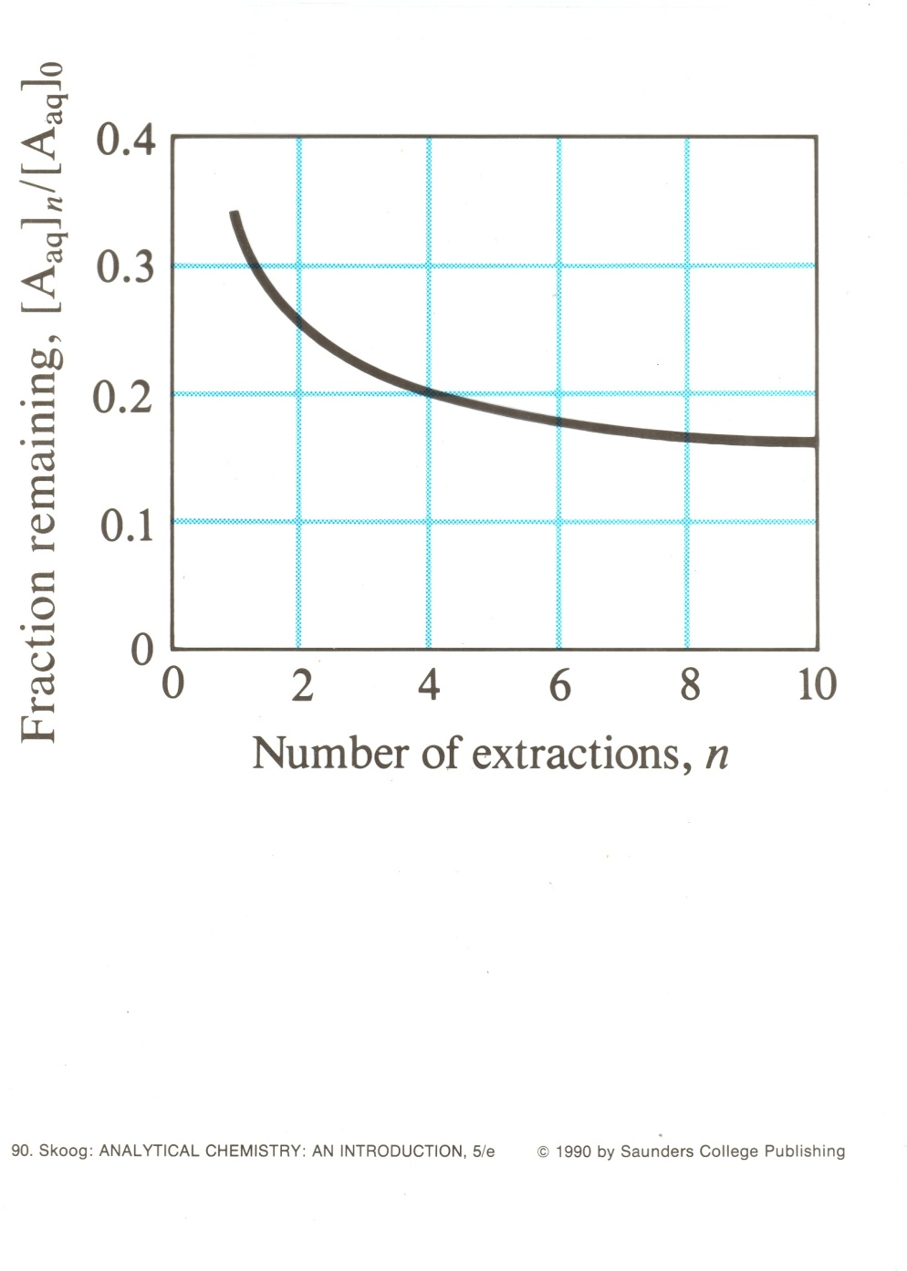
Successive extractions
Extracting with the same amount of solvent but divided into several smaller fractions, is more efficient.
Usually don’t do more than three successive extraction
K = 2,
Vaq = 100 mL,
Vorg = 100/n mL.

Slide 9


Some organic compounds can be made water-soluble.
Compounds belonging to the following solubility classes can be converted to their water-soluble salt form.
and
Organic acids include carboxylic acids (moderately weak organic acids) and phenols (weak organic acids).
Bases include amines

Slide 10
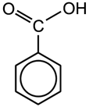
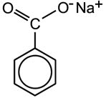
To a first approximation, in dilute solution, K_{D} is independent of concentration.
K_{D} pertains to a single species
Doesn’t include products of side reactions
Consider the distribution of benzoic acid between benzene and water

Slide 11

Separating species
Β-naphthol
Benzoic acid

Slide 12
pH < 2 Both non-ionic, both will transfer to benzene.
pH > 5 Benzoic acid is deprotonated and stays in water
-naphthol still transfers to benzene
pH 11 Both dissociate and both stay in water.

Slide 13
Some dimerizes in the organic phase
Each species has own K_{D}
But we are interested in total amount extracted

Slide 14
D is the Distribution ratio

Slide 15
Substitute:
then

Slide 16
For a weak acid which doesn’t dimerize – can simplify:

Slide 17
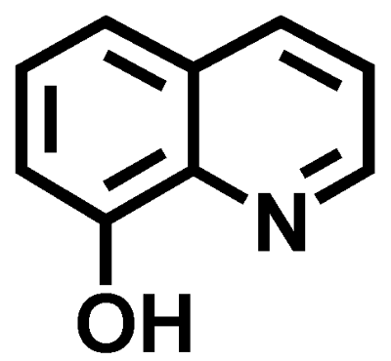
Metal ion Extraction
Must create a neutral, hydrophobic complex to extract into an organic phase.
We use chelating agents
E.g. 8-hydroxy-
quinoline
(oxine, 8-quinolinol)

Slide 18
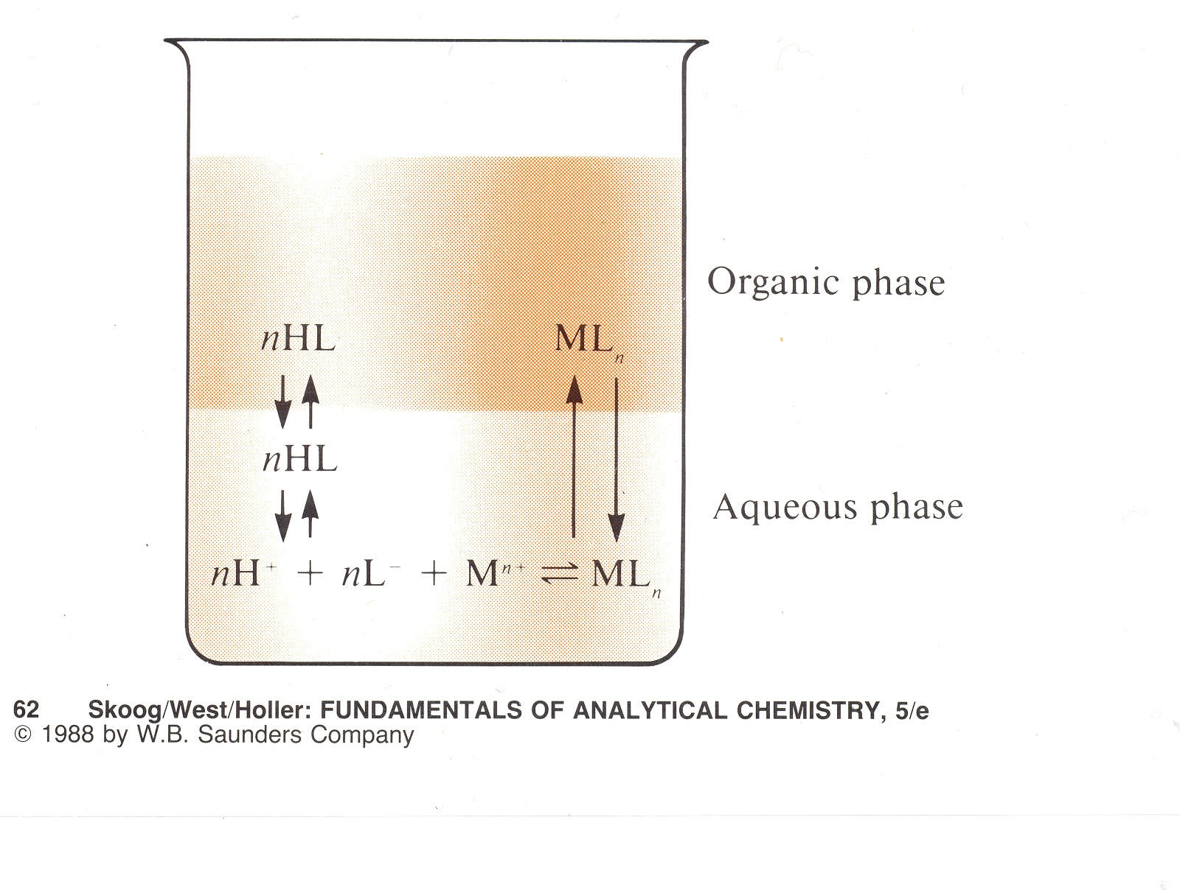

Slide 19

Complex formation is pH dependent, but the stronger the complex (K_{f}), the lower the pH which can be used.
Neutral species are extracted
Cu²⁺ + L²⁻ ⇔ CuL⁰
With Fe^{3+,} get (FeL)⁺ or (FeL₂)⁻
Therefore can separate Cu²⁺ from Fe³⁺

Slide 20

Another important reagent for the solvent extraction of metal ions is dithizone, diphenylthiocarbazone.

Slide 21
Some salts form complexes (ion pairs) which can be extracted
eg [FeCl₄]⁻H₃O⁺

Slide 22
Applications
Separation – controlled by pH which controls ionization and complex formation
Clean up before analysis
Preconcentration: Extract from a large aqueous volume into a much smaller organic volume.

Slide 23
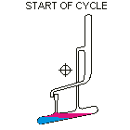
Counter current extraction
Craig method: you want to separate two species by solvent extration but their K_{D}s are not sufficiently different. So carry out a series of extractions:

Slide 24
Thank You

