Slide 1
Rotational Motion
By
Umesh Patil
Asst.Prof
Physics Department
S.T.E.s.& Co op E.S.Ltd.
Science Sr.college Shahada

Slide 2



Translational Mechanics
Rotational Mechanics
motion of point bodies
kinematics – translation
dynamics
conservation laws: energy & momentum
motion of “Rigid Bodies” (extended, finite size)
rotation + translation, more complex motions possible
rigid bodies: fixed size & shape, orientation matters
kinematics of rotation
dynamics
rotational modifications to energy conservation
conservation laws: energy & angular momentum

Slide 3

Rotational Motion
Angular position and radian
Angular displacement
Angular velocity
Angular acceleration
Rotational motion under constant angular acceleration
Relations between angular and linear quantities
Circular motion

Slide 4
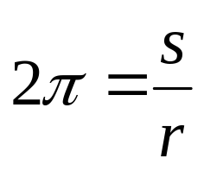
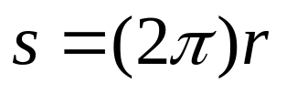
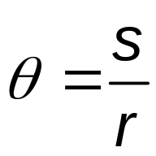
Angle and Radian
What is the circumference S ?
θ can be defined as the arc length s along a circle divided by the radius r:
θ is a pure number, but commonly is given the artificial unit, radian (“rad”)
r
s
θ
Whenever using rotational equations, you must use angles expressed in radians

Slide 5
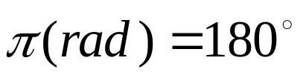
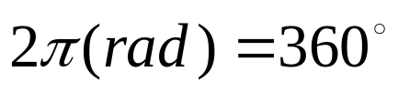
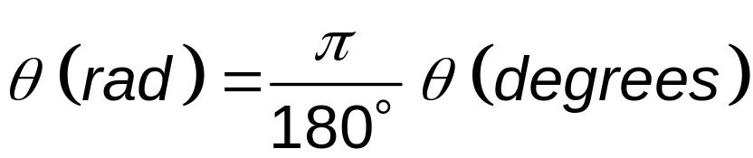
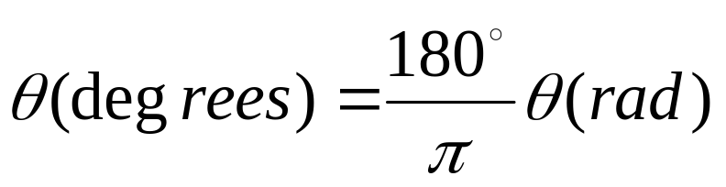
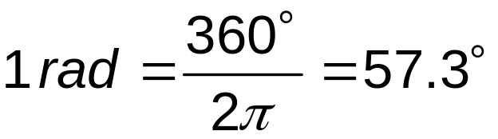
Conversions
Comparing degrees and radians
Converting from degrees to radians
Converting from radians to degrees

Slide 6
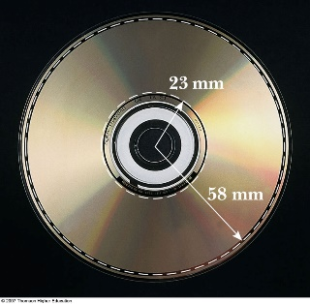
Rigid Object
A rigid object is one that is non-deformable
  The relative locations of all particles making up the object remain constant
  All real objects are deformable to some extent, but the rigid object model is very useful in many situations where the deformation is negligible
This simplification allows analysis of the motion of an extended object

Slide 7
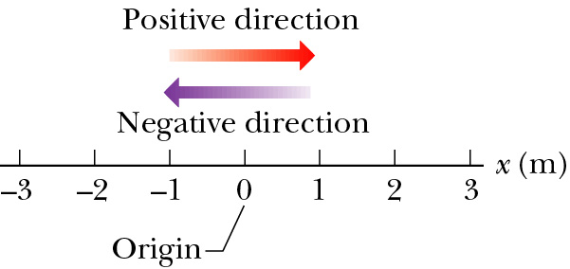
One Dimensional Position x
What is motion? Change of position over time.
How can we represent position along a straight line?
Position definition:
  Defines a starting point: origin (x = 0), x relative to origin
  Direction: positive (right or up), negative (left or down)
  It depends on time: t = 0 (start clock), x(t=0) does not have to be zero.
Position has units of [Length]: meters.
x = + 2.5 m
x = - 3 m

Slide 8
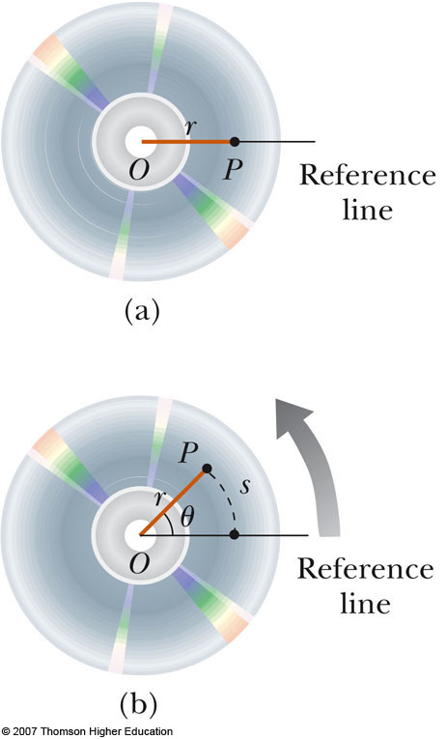
Angular Position
Axis of rotation is the center of the disc
Choose a fixed reference line
Point P is at a fixed distance r from the origin
As the particle moves, the only coordinate that changes is θ
As the particle moves through θ, it moves though an arc length s.
The angle θ, measured in radians, is called the angular position.

Slide 9

Displacement
Displacement is a change of position in time.
Displacement:
  f stands for final and i stands for initial.
It is a vector quantity.
It has both magnitude and direction: + or - sign
It has units of [length]: meters.
x₁ (t₁) = + 2.5 m
x₂ (t₂) = - 2.0 m
Δx = -2.0 m - 2.5 m = -4.5 m
x₁ (t₁) = - 3.0 m
x₂ (t₂) = + 1.0 m
Δx = +1.0 m + 3.0 m = +4.0 m

Slide 10
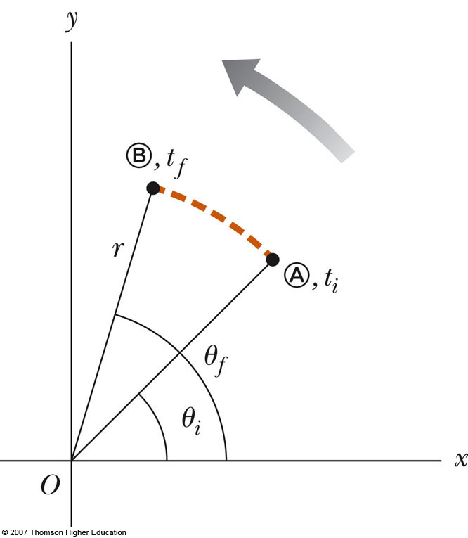
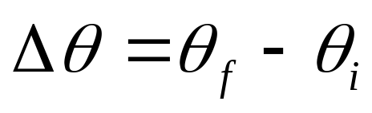
Angular Displacement
The angular displacement is defined as the angle the object rotates through during some time interval
SI unit: radian (rad)
This is the angle that the reference line of length r sweeps out

Slide 11



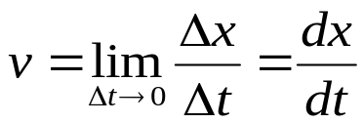
Velocity
Velocity is the rate of change of position.
Velocity is a vector quantity.
Velocity has both magnitude and direction.
Velocity has a unit of [length/time]: meter/second.
Definition:
Average velocity
  Average speed
  Instantaneous
  velocity

Slide 12
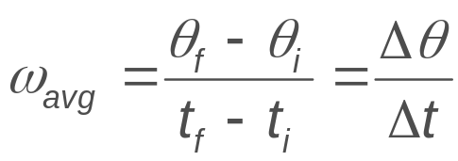
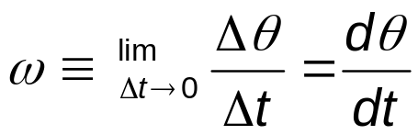
Average and Instantaneous
Angular Speed
The average angular speed, ω_{avg}, of a rotating rigid object is the ratio of the angular displacement to the time interval
The instantaneous angular speed is defined as the limit of the average speed as the time interval approaches zero
SI unit: radian per second (rad/s)
Angular speed positive if rotating in counterclockwise
Angular speed will be negative if rotating in clockwise

Slide 13
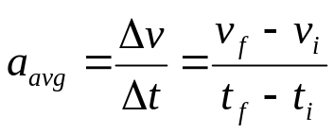
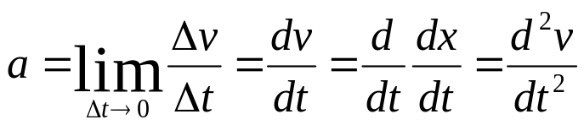
Average Acceleration
Changing velocity (non-uniform) means an acceleration is present.
Acceleration is the rate of change of velocity.
Acceleration is a vector quantity.
Acceleration has both magnitude and direction.
Acceleration has a unit of [length/time²]: m/s².
Definition:
  Average acceleration
  Instantaneous acceleration

Slide 14
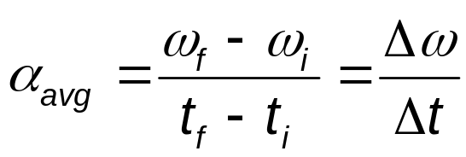
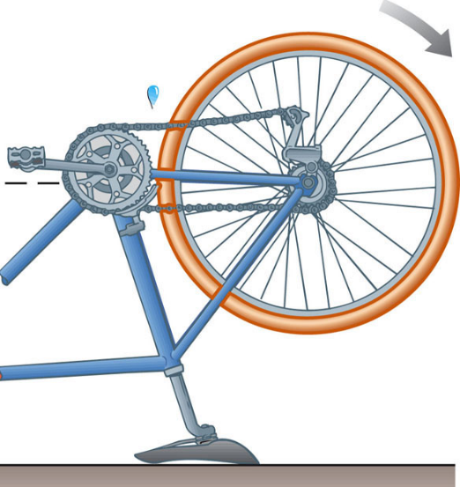
Average Angular Acceleration
The average angular acceleration, α, of an object is defined as the ratio of the change in the angular speed to the time it takes for the object to undergo the change:
t = t_{i}: ω_{i}
t = t_{f}: ω_{f}

Slide 15
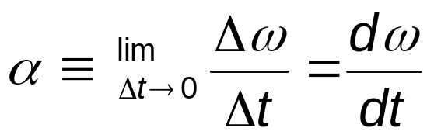
Instantaneous Angular Acceleration
The instantaneous angular acceleration is defined as the limit of the average angular acceleration as the time goes to 0
SI Units of angular acceleration: rad/s²
Positive angular acceleration is in the counterclockwise.
  if an object rotating counterclockwise is speeding up
  if an object rotating clockwise is slowing down
Negative angular acceleration is in the clockwise.
  if an object rotating counterclockwise is slowing down
  if an object rotating clockwise is speeding up

Slide 16
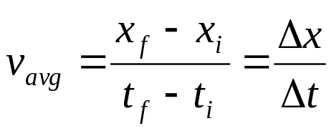
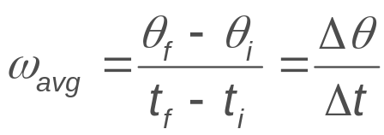
Rotational Kinematics
A number of parallels exist between the equations for rotational motion and those for linear motion.
Under constant angular acceleration, we can describe the motion of the rigid object using a set of kinematic equations
  These are similar to the kinematic equations for linear motion
  The rotational equations have the same mathematical form as the linear equations

Slide 17
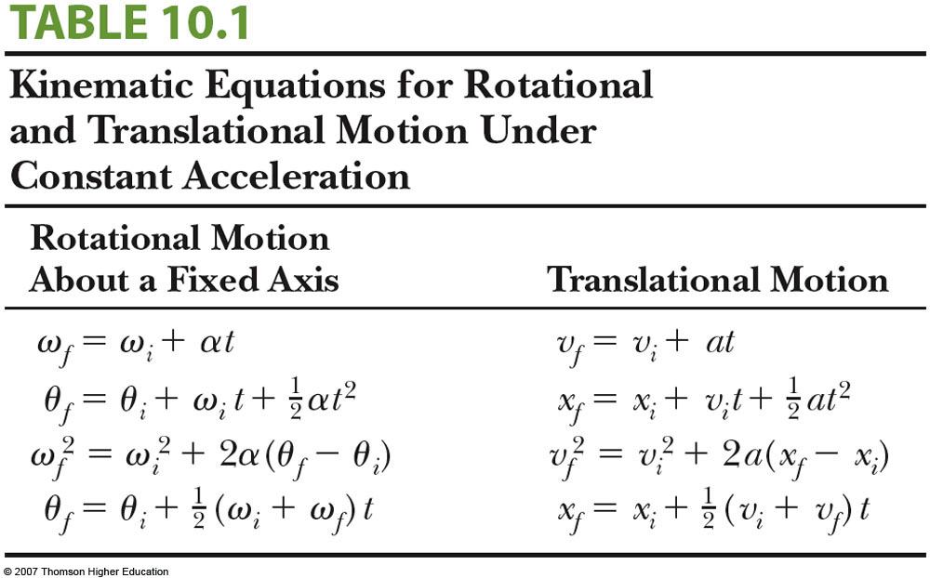
Comparison Between Rotational and Linear Equations

Slide 18
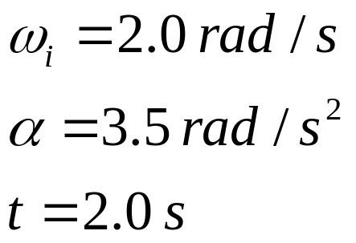
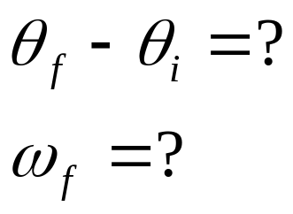
A Rotating Wheel
A wheel rotates with a constant angular acceleration of 3.5 rad/s². If the angular speed of the wheel is 2.0 rad/s at t = 0
(a) through what angle does the wheel rotate between
t = 0 and t = 2.0 s? Given your answer in radians and in revolutions.
(b) What is the angular speed of the wheel at t = 2.0 s?

Slide 19
Hints for Problem-Solving
Similar to the techniques used in linear motion problems
  With constant angular acceleration, the techniques are much like those with constant linear acceleration
There are some differences to keep in mind
  For rotational motion, define a rotational axis
    The choice is arbitrary
    Once you make the choice, it must be maintained
    In some problems, the physical situation may suggest a natural axis
  The object keeps returning to its original orientation, so you can find the number of revolutions made by the body

Slide 20
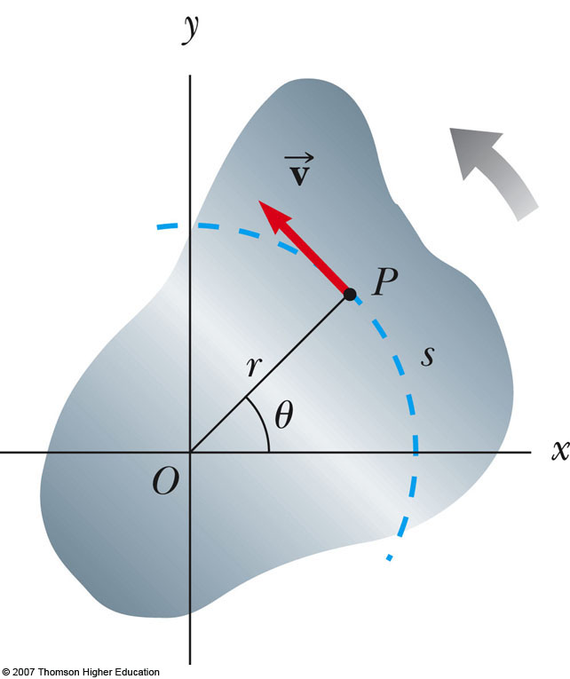
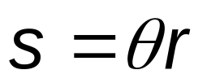

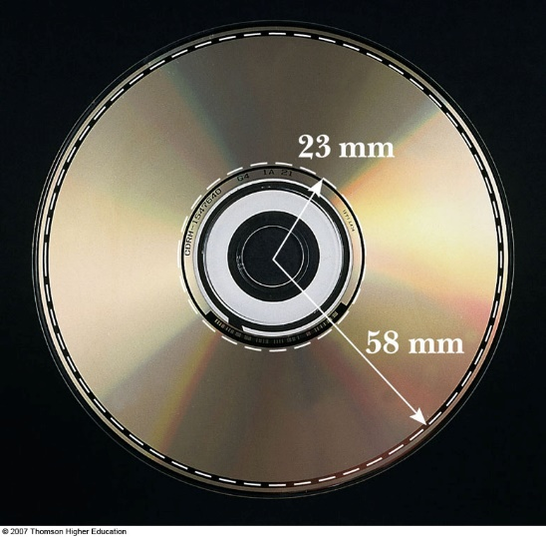

Relationship Between Angular and Linear Quantities
Every point on the rotating object has the same angular motion
Every point on the rotating object does not have the same linear motion
Displacement
Speeds
Accelerations

Slide 21

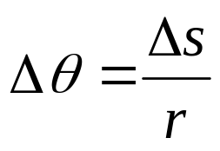
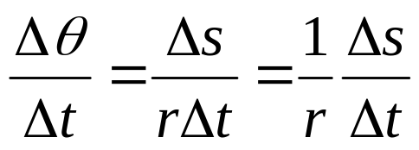
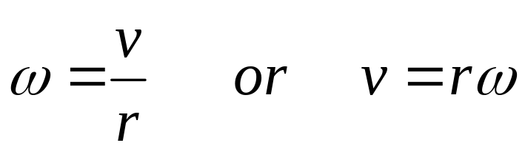
Speed Comparison
The linear velocity is always tangent to the circular path
  Called the tangential velocity
The magnitude is defined by the tangential speed

Slide 22
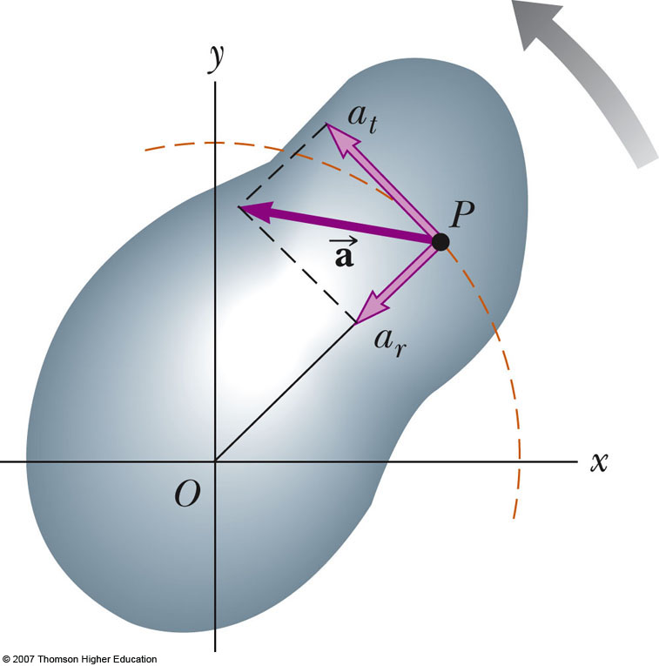

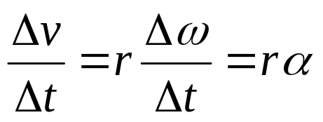
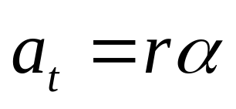
Acceleration Comparison
The tangential acceleration is the derivative of the tangential velocity

Slide 23
Speed and Acceleration Note
All points on the rigid object will have the same angular speed, but not the same tangential speed
All points on the rigid object will have the same angular acceleration, but not the same tangential acceleration
The tangential quantities depend on r, and r is not the same for all points on the object

Slide 24
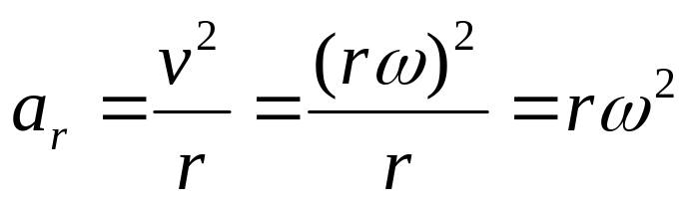
Centripetal Acceleration
An object traveling in a circle, even though it moves with a constant speed, will have an acceleration
  Therefore, each point on a rotating rigid object will experience a centripetal acceleration

Slide 25

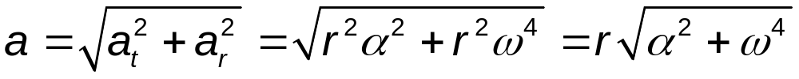
Resultant Acceleration
The tangential component of the acceleration is due to changing speed
The centripetal component of the acceleration is due to changing direction
Total acceleration can be found from these components

Slide 26

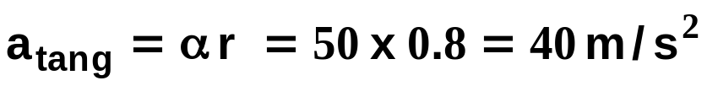


Angular kinematics example: Discus Thrower
Arm rotates as rigid body: r = 0.8 m
Constant angular acceleration α = 50 rad/s²
Find the tangential and radial (centripetal)
components of the acceleration
r
constant magnitude
direction: tangent to rotary motion
ω not constant
Start from rest → ω₀ = 0
centripetal acceleration growing rapidly as square of time

Slide 27
Angular acceleration
A race track is constructed such that two arcs of radius 80 m at point A and 40 m at point B are joined by two stretches of straight track. In a particular trail run, a driver travels at a constant speed of 50 m/s for one complete lap.
1) Find the ratio of the tangential
acceleration at A to that at B
2) Find the ratio of the centripetal
acceleration at A to that at B
B
A

Slide 28
Questions?

Slide 29
Thank You

